Slide 1
We regularly interact with a lot of people around us and notice problems they face on a day-to-day basis. As a product manager you have a keen eye for such hurdles and acknowledge the need to work on it.
Tell us about a real-world problem that you have observed around you which can be solved using a digital product.
MALLURI HEMANTH KUMAR
Roll No. - 160040096
160040096@iitb.ac.in

Slide 2
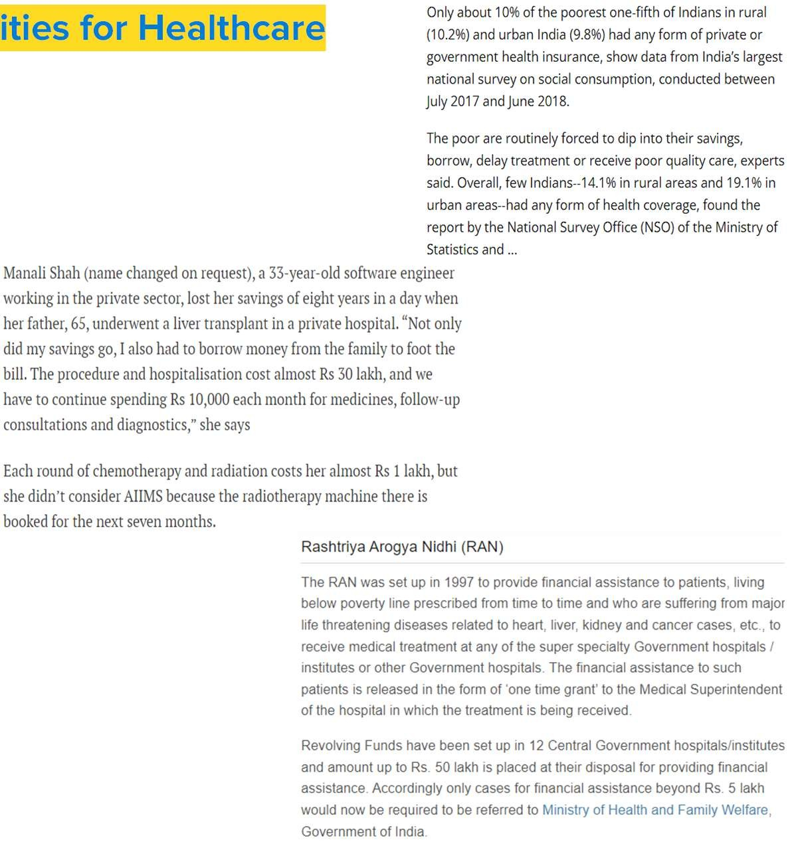



Problem: Accessing Medical and Financial facil
ities for Healthcare
Current System
Unawareness or
Lack of Access??
Paperwork
Time Consuming
Loss of Life
A lot of paperwork is required to avail both medical and financial facilities
A great amount of time is spent in validating individual applications
Many lives are lost every year due to unaffordability of medical facilities
Unaffordability or Unavailability??
Bob need to undergo a surgery. He goes to a hospital but finds that he cannot afford that surgery. He tries 2-3 more hospitals but fails to get a treatment
Bob goes to a bank for loan but they ask for a lot of paperwork and it is very time consuming process. He needs to visit the bank regularly to get his job done
Complex Process or
Lack of Knowledge??
Bob is very stressed and his health condition is getting worse everyday, he is confused about how to get help for the treatment or what other options are possible

Slide 3
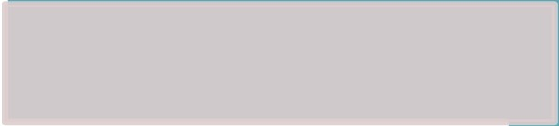
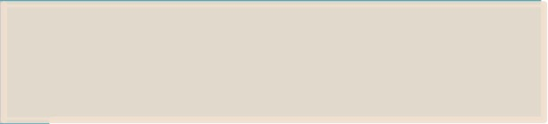


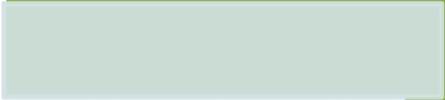
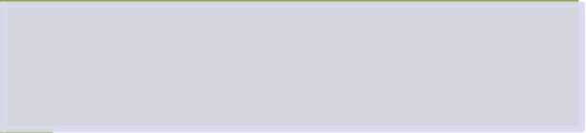


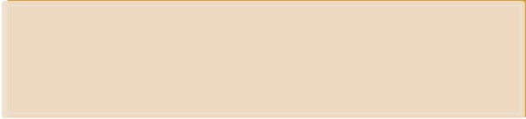
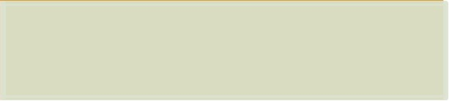
Getting Started with Digital Platform
Data Collection and Digitalization
A platform connecting hospitals to insurance companies providing users a one-stop solution to know and access the services available
Collecting data of end-users, medical institutes and financial institutes
Cleaning and validating data using proofs, certificates, and other documents (one time process)
Approaching hospitals to know about their medical facilities and cost of every service and medicine
Data Integration
Gathering data about health insurance and other services through financial institutes like banks, insurance agencies, etc.
Connecting medical facilities to relevant schemes provided by financial institutions
Providing personalized suggestions to end-users about useful facilities based on their profile
Generating database of end users importing their basic details and general physical and medical data
Validating users’ data using government issued Id to avoid fraudulent and duplicate entries
Testing Services
Implementing personalized Chatbot for Verification of connectivity of medical & simplifying the use of platform financial institutions and end users

Slide 4
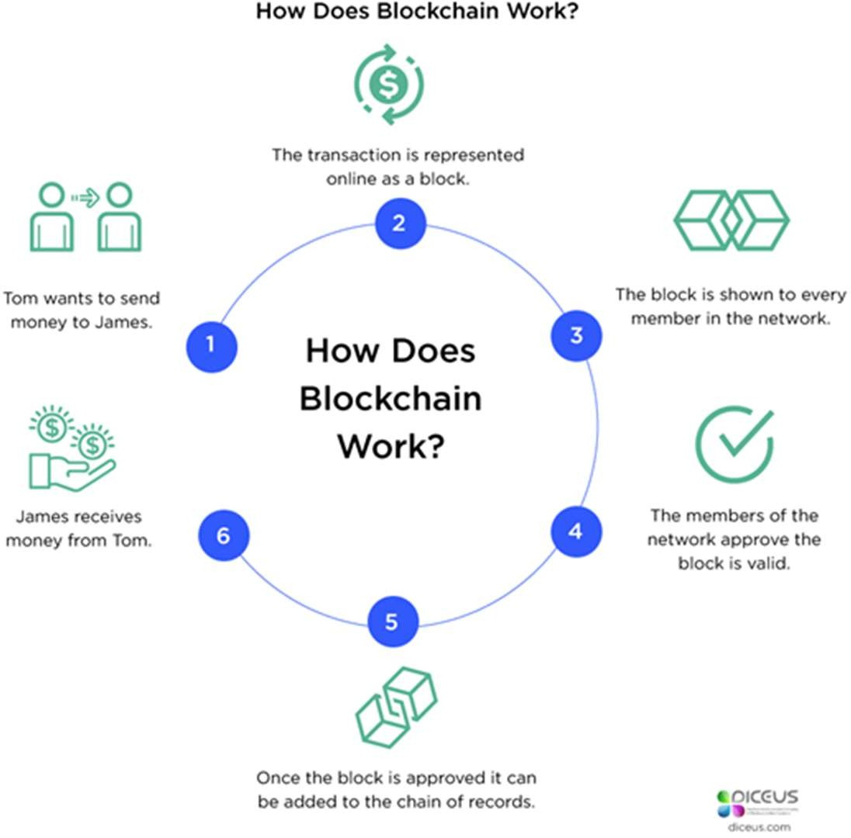
Using Blockchain Technology for Integration
Blockchain Technology
Alice registers on the platform and uploads her documents for verification
After verification, Alice searches for required medical facility and select a hospital of her choice
Alice finds that the treatment is very costly and she cannot afford it on her own
Alice gets assistance suggestions for concerned medical facility and she can select any financial institute/ NGO/ government scheme of her choice for support
Alice does not need to do any paperwork, she also does not need to pay directly to the hospital, the finance company automatically pays all the hospital charges after approval
Alice get the treatment without worrying about financial restrictions, Alice is happy. She will repay the bank/NGO as per their scheme, she will get regular updates from the platform regarding the same

Slide 5



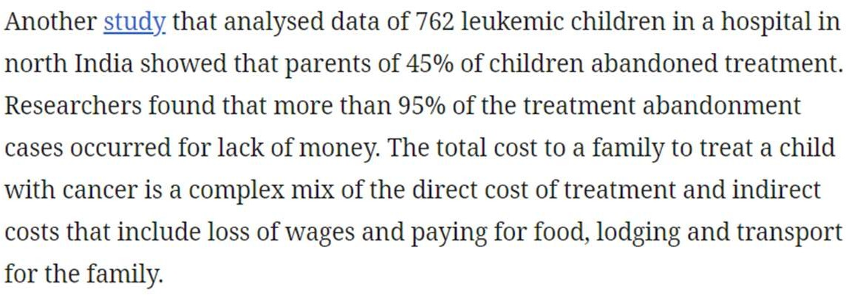
Potential Impacts of Solving the Problem
Potential Impacts
Awareness and Availability
Revenue Sources
All the medical facilities and financial support schemes will be available for everyone
Affordability
End-users can get medical facilities at a fixed cost and can also opt for financial support
Hospitals to be charged upto 3% for every transaction happening through the platform
Financial Institutes to be charged as per the support scheme opted by end-users
Easier Management
Monitoring & managing the data of hospitals, NGOs, banks, insurance companies, etc. would be simpler
Our Goal – The 3 A’s
Availability Accessibility Affordability
of healthcare services

Slide 6

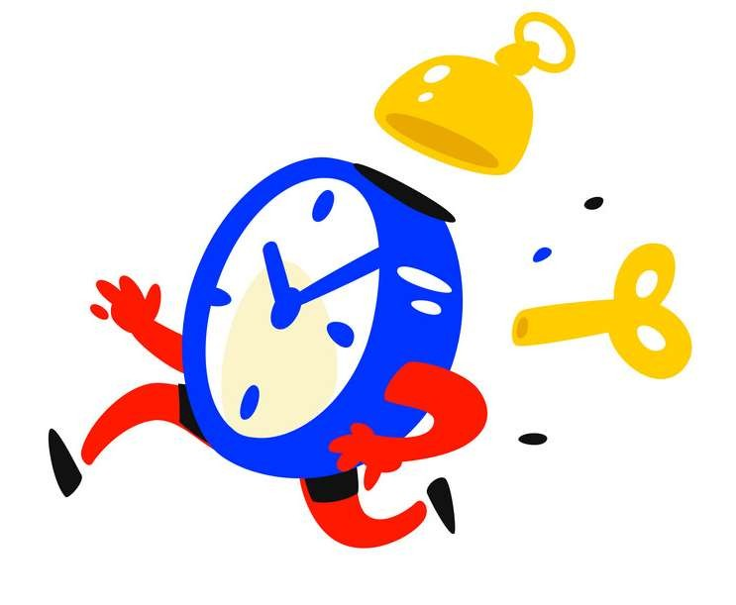
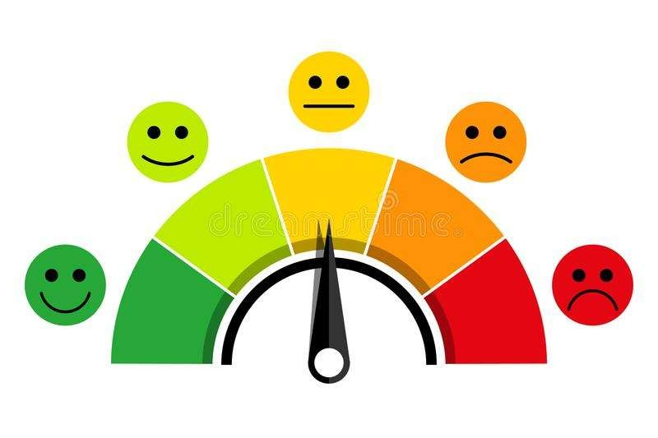

Measuring Success of the Solution
Monitoring transactions and analyzing for complete/ incomplete requests, number of unverified users
Number of (unique and total) users registered on the platform
Time taken to completely process a request made by the end-user Frequency of users selecting recommended facilities based on their profile
Keeping track of the ratings provided by users for each feature
Regularly taking in-platform feedback of user’s views about what they like and dislike in the platform Net promoter score: (percentage of promoters) – (percentage of detractors) {passives not included}

Slide 7
Challenges
Possible Drawbacks and Challenges
Data Security
Fraud-Proof System
Building Trust
Malicious Users
There will be a lot of confidential data in the system which needs to be saved from attackers
Blockchain Technology provides cryptographic encryption providing security along with data transparency
Need to build trust among users, medical and financial institutions about the platform
Need to incentivize the institutes so that they come forward to be a part of the platform
Some users might try to commit frauds by exploiting flaws in the system
Making fool- proof system can be one of the challenges
Proper verification of all the provided documents might be a time consuming task
However, it is a one time task so it won’t cause delay every time

